Slide 1



Estimating Multiple Item-Sets: Harder Than You Think!
Paul Garrett¹, Zachary Howard¹, Joseph Houpt², David Landy³ & Ami Eidels¹
¹The University of Newcastle
²Wright State University
³University of Indiana

Slide 2

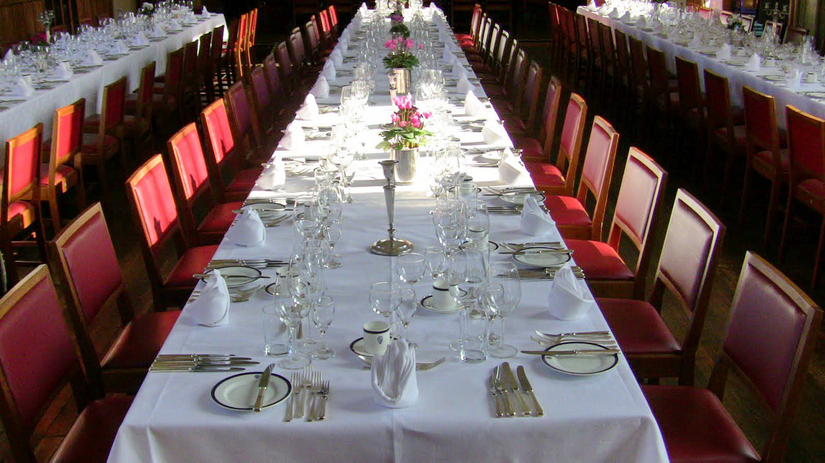

Paul Garrett
SPPC 2018
Background
Method
Results
Discussion
Conclusion
- Enumeration
Notes:
Everyday, we view complex scenes full of countable items.
From, the number of signs in a street,
To the number of plates at a table,
To the Lego carpeting your floor.
At a young age, we learn to focus our attention to a sub-set of these items, and enumerate their quantity.
To do this, we may apply one of two methods: counting, or estimation.
Counting is a slow and deliberate process, where we quantify the item-set by sequentially counting every single unit
Estimation is a fast, and rather inaccurate process, where we quantify the item-set all at the same time.

Slide 3

Paul Garrett
SPPC 2018
Counting
Background
Method
Results
Discussion
Conclusion
Slow and accurate. Judgements of Absolute Value.
e.g., How many blue blocks?
- Enumeration
1
2
3
4
5
6
7
…
Notes:
Everyday, we view complex scenes full of countable items.
From, the number of signs in a street,
To the number of plates at a table,
To the Lego carpeting your floor.
At a young age, we learn to focus our attention to a sub-set of these items, and enumerate their quantity.
To do this, we may apply one of two methods: counting, or estimation.
Counting is a slow and deliberate process, where we quantify the item-set by sequentially counting every single unit
Estimation is a fast, and rather inaccurate process, where we quantify the item-set all at the same time.

Slide 4
Paul Garrett
SPPC 2018
Counting
Background
Method
Results
Discussion
Conclusion
Slow and accurate. Judgements of Absolute Value.
e.g., How many blue blocks?
- Enumeration
Estimation
Fast and inaccurate. Judgments of Magnitude.
e.g., Are there more blue blocks, than…?
~10
Notes:
Everyday, we view complex scenes full of countable items.
From, the number of signs in a street,
To the number of plates at a table,
To the Lego carpeting your floor.
At a young age, we learn to focus our attention to a sub-set of these items, and enumerate their quantity.
To do this, we may apply one of two methods: counting, or estimation.
Counting is a slow and deliberate process, where we quantify the item-set by sequentially counting every single unit
Estimation is a fast, and rather inaccurate process, where we quantify the item-set all at the same time.

Slide 5

Paul Garrett
SPPC 2018
Counting
Background
Method
Results
Discussion
Conclusion
Slow and accurate. Judgements of Absolute Value.
e.g., How many blue blocks?
- Enumeration
Estimation
Fast and inaccurate. Judgments of Magnitude.
e.g., Are there more blue blocks, than…?
~10
Notes:
Everyday, we view complex scenes full of countable items.
From, the number of signs in a street,
To the number of plates at a table,
To the Lego carpeting your floor.
At a young age, we learn to focus our attention to a sub-set of these items, and enumerate their quantity.
To do this, we may apply one of two methods: counting, or estimation.
Counting is a slow and deliberate process, where we quantify the item-set by sequentially counting every single unit
Estimation is a fast, and rather inaccurate process, where we quantify the item-set all at the same time.

Slide 6
How does the human brain estimate two item-sets at the same time?
Paul Garrett
SPPC 2018
Background
Method
Results
Discussion
Conclusion
- Enumeration
Notes:
Everyday, we view complex scenes full of countable items.
From, the number of signs in a street,
To the number of plates at a table,
To the Lego carpeting your floor.
At a young age, we learn to focus our attention to a sub-set of these items, and enumerate their quantity.
To do this, we may apply one of two methods: counting, or estimation.
Counting is a slow and deliberate process, where we quantify the item-set by sequentially counting every single unit
Estimation is a fast, and rather inaccurate process, where we quantify the item-set all at the same time.

Slide 7


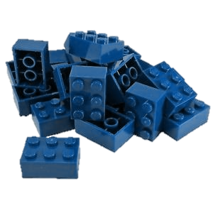
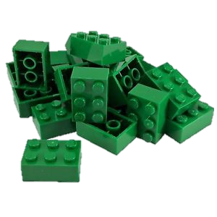

Paul Garrett
SPPC 2018
Serial Processing System
Background
Method
Results
Discussion
Conclusion
- Architecture
Parallel
Processing System
Notes:
Everyday, we view complex scenes full of countable items.
From, the number of signs in a street,
To the number of plates at a table,
To the Lego carpeting your floor.
At a young age, we learn to focus our attention to a sub-set of these items, and enumerate their quantity.
To do this, we may apply one of two methods: counting, or estimation.
Counting is a slow and deliberate process, where we quantify the item-set by sequentially counting every single unit
Estimation is a fast, and rather inaccurate process, where we quantify the item-set all at the same time.

Slide 8
Paul Garrett
SPPC 2018
First-Terminating (Min) Stopping Rule – ‘OR’
Background
Method
Results
Discussion
Conclusion
- Stopping Rule
Exhaustive (Max) Stopping Rule – ‘AND’
Notes:
Everyday, we view complex scenes full of countable items.
From, the number of signs in a street,
To the number of plates at a table,
To the Lego carpeting your floor.
At a young age, we learn to focus our attention to a sub-set of these items, and enumerate their quantity.
To do this, we may apply one of two methods: counting, or estimation.
Counting is a slow and deliberate process, where we quantify the item-set by sequentially counting every single unit
Estimation is a fast, and rather inaccurate process, where we quantify the item-set all at the same time.

Slide 9
Paul Garrett
SPPC 2018
Background
Method
Results
Discussion
Conclusion
Unlimited
Capacity
(fast)
- Capacity
Limited
Capacity
(slow)
Notes:
Everyday, we view complex scenes full of countable items.
From, the number of signs in a street,
To the number of plates at a table,
To the Lego carpeting your floor.
At a young age, we learn to focus our attention to a sub-set of these items, and enumerate their quantity.
To do this, we may apply one of two methods: counting, or estimation.
Counting is a slow and deliberate process, where we quantify the item-set by sequentially counting every single unit
Estimation is a fast, and rather inaccurate process, where we quantify the item-set all at the same time.

Slide 10
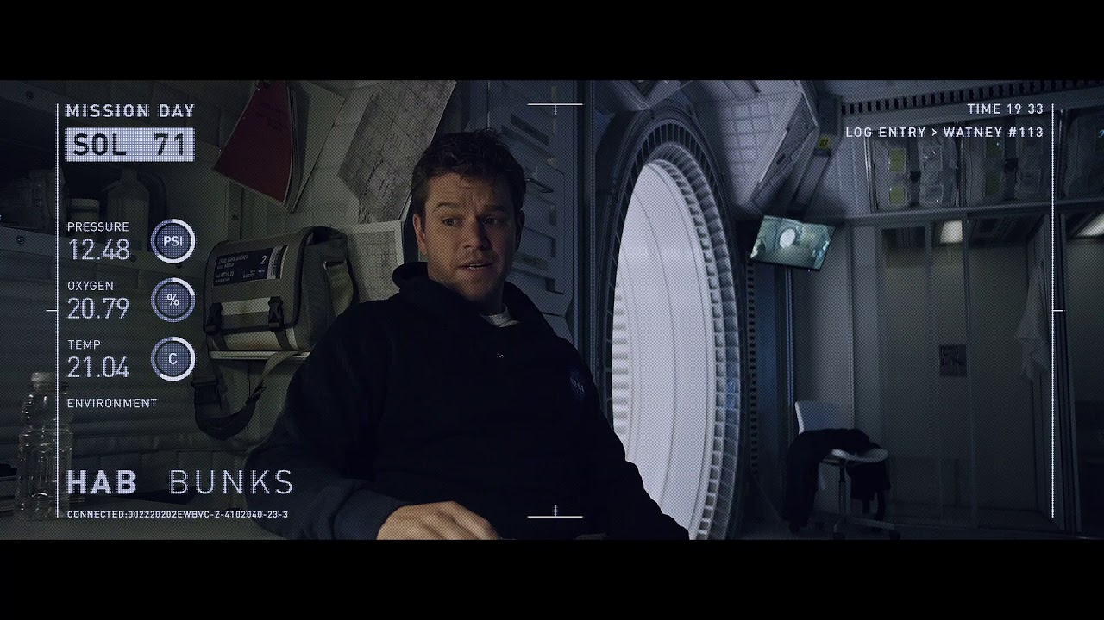
Systems Factorial Technology (SFT)
Paul Garrett
SPPC 2018
In the face of overwhelming item-sets I'm left with only one option:
Background
Method
Results
Discussion
Conclusion
- Architecture
I’m going to have to SFT the shit out of this .
Notes:
Everyday, we view complex scenes full of countable items.
From, the number of signs in a street,
To the number of plates at a table,
To the Lego carpeting your floor.
At a young age, we learn to focus our attention to a sub-set of these items, and enumerate their quantity.
To do this, we may apply one of two methods: counting, or estimation.
Counting is a slow and deliberate process, where we quantify the item-set by sequentially counting every single unit
Estimation is a fast, and rather inaccurate process, where we quantify the item-set all at the same time.

Slide 11
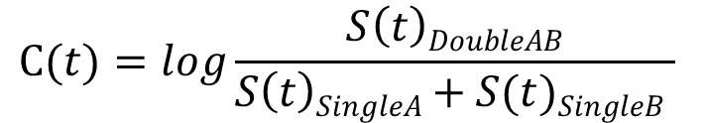
Systems Factorial Technology (SFT)
Paul Garrett
SPPC 2018
Background
Method
Results
Discussion
Conclusion
Methodology + Analysis Tool Kit
- Mean and Distribution Based Analyses
- Theoretically Driven Model Predictions
Target A
Present
Absent
- SFT
Capacity Coefficient
$$C(t)=log\frac{S\left(t\right)DoubleAB}{S\left(t\right)SingleA+S(t)SingleB }$$
Present
Target B
Absent
Notes:
Everyday, we view complex scenes full of countable items.
From, the number of signs in a street,
To the number of plates at a table,
To the Lego carpeting your floor.
At a young age, we learn to focus our attention to a sub-set of these items, and enumerate their quantity.
To do this, we may apply one of two methods: counting, or estimation.
Counting is a slow and deliberate process, where we quantify the item-set by sequentially counting every single unit
Estimation is a fast, and rather inaccurate process, where we quantify the item-set all at the same time.

Slide 12
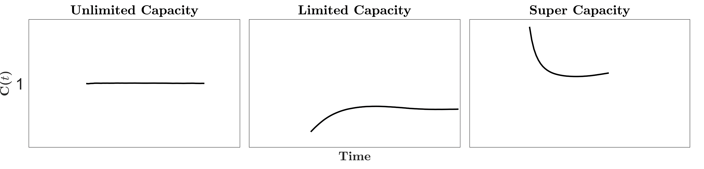
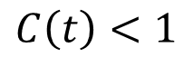
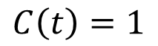
Systems Factorial Technology (SFT)
Paul Garrett
SPPC 2018
Background
Method
Results
Discussion
Conclusion
Methodology + Analysis Tool Kit
- Mean and Distribution Based Analyses
- Theoretically Driven Model Predictions
Target A
Present
Absent
- SFT
Capacity Coefficient
$$C(t)=log\frac{S\left(t\right)DoubleAB}{S\left(t\right)SingleA+S(t)SingleB }$$
Present
Target B
$$C\left(t\right)=1$$
$$C\left(t\right)<1$$
Absent
Notes:
Everyday, we view complex scenes full of countable items.
From, the number of signs in a street,
To the number of plates at a table,
To the Lego carpeting your floor.
At a young age, we learn to focus our attention to a sub-set of these items, and enumerate their quantity.
To do this, we may apply one of two methods: counting, or estimation.
Counting is a slow and deliberate process, where we quantify the item-set by sequentially counting every single unit
Estimation is a fast, and rather inaccurate process, where we quantify the item-set all at the same time.

Slide 13
Systems Factorial Technology (SFT)
Paul Garrett
SPPC 2018
Background
Method
Results
Discussion
Conclusion
Methodology + Analysis Tool Kit
- Mean and Distribution Based Analyses
- Theoretically Driven Model Predictions
Target A
Present
Absent
- SFT
Architecture – Parallel/Serial
High Low
HH
LH
$$SIC= {S(t)}_{HH} − {S(t)}_{HL} − {S(t)}_{LH}+ {S(t)}_{LL}$$
$$MIC={RT}_{HH} − {RT}_{HL} − {RT}_{LH}+ {RT}_{LL}$$
Present
Low High
Target B
HL
LL
Absent
Notes:
Everyday, we view complex scenes full of countable items.
From, the number of signs in a street,
To the number of plates at a table,
To the Lego carpeting your floor.
At a young age, we learn to focus our attention to a sub-set of these items, and enumerate their quantity.
To do this, we may apply one of two methods: counting, or estimation.
Counting is a slow and deliberate process, where we quantify the item-set by sequentially counting every single unit
Estimation is a fast, and rather inaccurate process, where we quantify the item-set all at the same time.

Slide 14
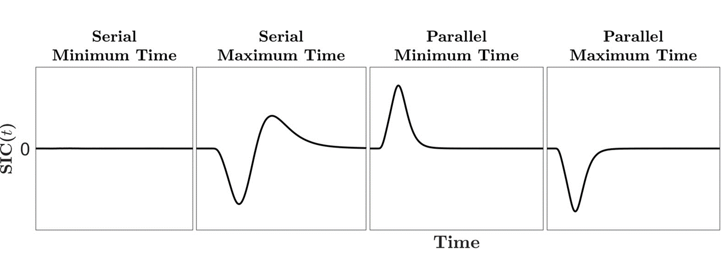
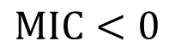
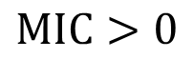
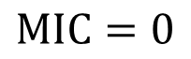
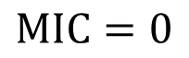
Systems Factorial Technology (SFT)
Paul Garrett
SPPC 2018
Background
Method
Results
Discussion
Conclusion
Methodology + Analysis Tool Kit
- Mean and Distribution Based Analyses
- Theoretically Driven Model Predictions
Target A
Present
Absent
- SFT
Architecture – Parallel/Serial
High Low
HH
LH
$$SIC= {S(t)}_{HH} − {S(t)}_{HL} − {S(t)}_{LH}+ {S(t)}_{LL}$$
$$MIC={RT}_{HH} − {RT}_{HL} − {RT}_{LH}+ {RT}_{LL}$$
Present
Low High
Target B
HL
LL
$$MIC=0$$
$$MIC=0$$
$$MIC>0$$
$$MIC<0$$
Absent
Notes:
Everyday, we view complex scenes full of countable items.
From, the number of signs in a street,
To the number of plates at a table,
To the Lego carpeting your floor.
At a young age, we learn to focus our attention to a sub-set of these items, and enumerate their quantity.
To do this, we may apply one of two methods: counting, or estimation.
Counting is a slow and deliberate process, where we quantify the item-set by sequentially counting every single unit
Estimation is a fast, and rather inaccurate process, where we quantify the item-set all at the same time.

Slide 15
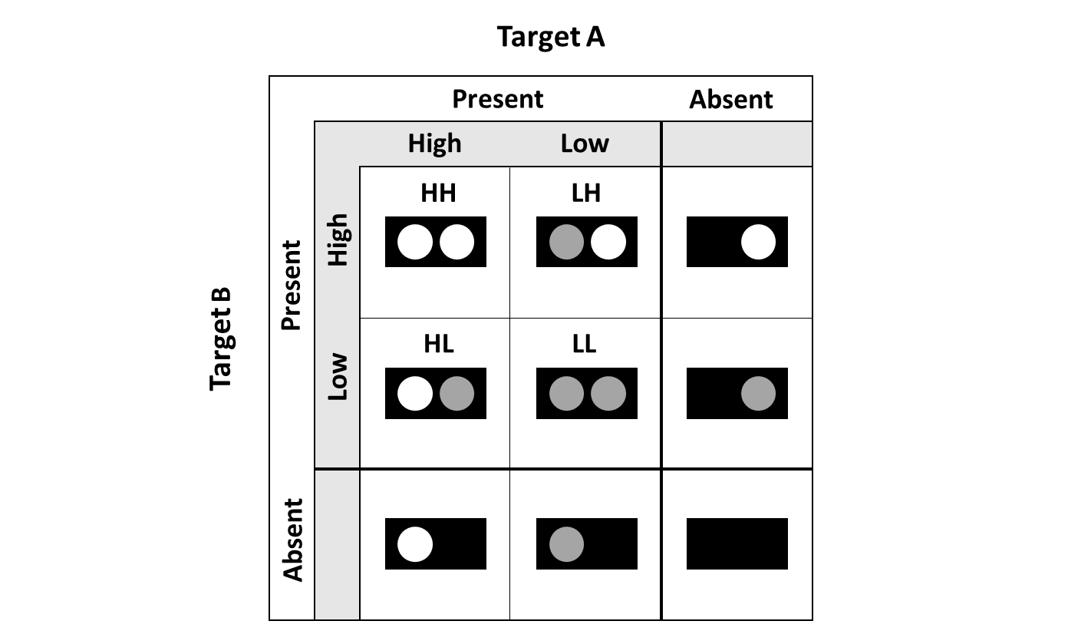
Systems Factorial Technology (SFT)
Paul Garrett
SPPC 2018
Background
Method
Results
Discussion
Conclusion
Task:
- View two item-sets (Red & Blue) - Decide if either item-set contains less than 20 discs?
- SFT
- Target – Sets Less Than 20
- Salience – Numerical Distance effect (NDE)
- NDE – Closer-item sets are slower/harder to respond to, than item-
sets further apart
e.g., 14 vs 20 – hard (Low Salience) e.g., 10 vs 20 – easy (High Salience)
Notes:
Everyday, we view complex scenes full of countable items.
From, the number of signs in a street,
To the number of plates at a table,
To the Lego carpeting your floor.
At a young age, we learn to focus our attention to a sub-set of these items, and enumerate their quantity.
To do this, we may apply one of two methods: counting, or estimation.
Counting is a slow and deliberate process, where we quantify the item-set by sequentially counting every single unit
Estimation is a fast, and rather inaccurate process, where we quantify the item-set all at the same time.

Slide 16
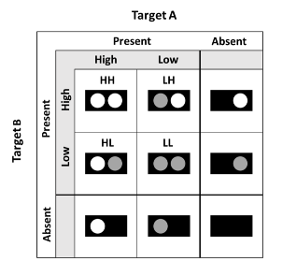
Systems Factorial Technology (SFT)
Paul Garrett
SPPC 2018
Target Red
Background
Method
Results
Discussion
Conclusion
Task:
- View two item-sets (Red & Blue) - Decide if either item-set contains less than 20 discs?
Present
Absent
Dt.
Salience Red
Ct.
Salience Red
Single Target
High
Low
High
Low
Red
Blue
10
- SFT
High
10
10
14
10
High
41
10
29
10
High
10
Present
Salience Blue
Salience Blue
10
14
14
14
41
14
29
14
14
14
Low
Low
Low
- Target – Sets Less Than 20
Target Blue
Ct.
Salience Red
Dd.
Salience Red
Single Distractor
- Salience – Numerical Distance effect (NDE)
High
Low
High
Low
Red
Blue
- NDE – Closer-item sets are slower/harder to respond to, than item-
sets further apart
e.g., 14 vs 20 – hard (Low Salience) e.g., 10 vs 20 – easy (High Salience)
High
10
41
14
41
41
41
29
41
41
41
High
High
Absent
Salience Blue
Salience Blue
10
29
14
29
41
29
29
29
29
29
Low
Low
Low
Notes:
Everyday, we view complex scenes full of countable items.
From, the number of signs in a street,
To the number of plates at a table,
To the Lego carpeting your floor.
At a young age, we learn to focus our attention to a sub-set of these items, and enumerate their quantity.
To do this, we may apply one of two methods: counting, or estimation.
Counting is a slow and deliberate process, where we quantify the item-set by sequentially counting every single unit
Estimation is a fast, and rather inaccurate process, where we quantify the item-set all at the same time.

Slide 17
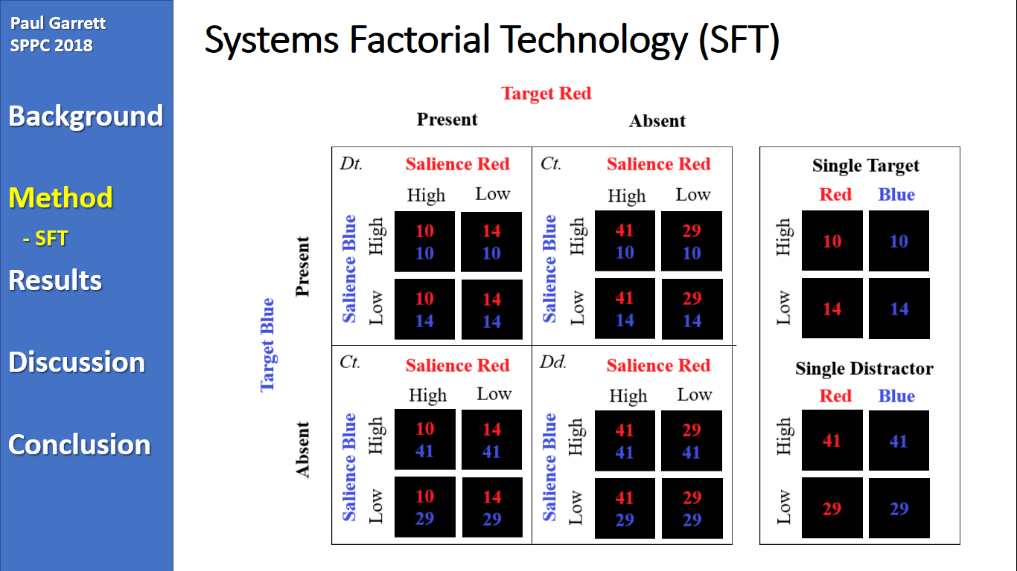
Systems Factorial Technology (SFT)
Paul Garrett
SPPC 2018
Background
Method
Results
Discussion
Conclusion
- SFT
Notes:
Everyday, we view complex scenes full of countable items.
From, the number of signs in a street,
To the number of plates at a table,
To the Lego carpeting your floor.
At a young age, we learn to focus our attention to a sub-set of these items, and enumerate their quantity.
To do this, we may apply one of two methods: counting, or estimation.
Counting is a slow and deliberate process, where we quantify the item-set by sequentially counting every single unit
Estimation is a fast, and rather inaccurate process, where we quantify the item-set all at the same time.

Slide 18
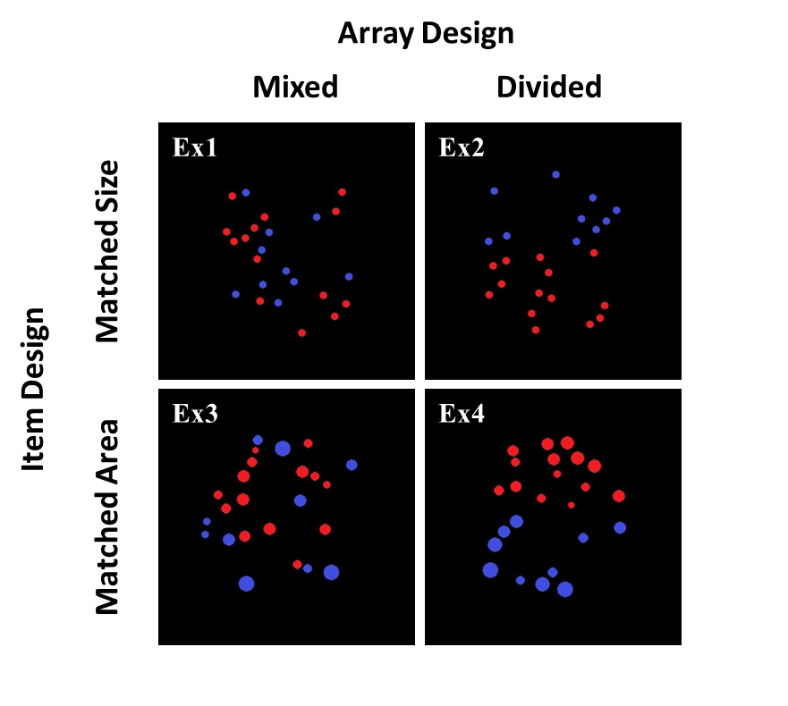
Item-Set Design
Paul Garrett
SPPC 2018
Background
Method
Results
Discussion
Conclusion
- Design
Notes:
Everyday, we view complex scenes full of countable items.
From, the number of signs in a street,
To the number of plates at a table,
To the Lego carpeting your floor.
At a young age, we learn to focus our attention to a sub-set of these items, and enumerate their quantity.
To do this, we may apply one of two methods: counting, or estimation.
Counting is a slow and deliberate process, where we quantify the item-set by sequentially counting every single unit
Estimation is a fast, and rather inaccurate process, where we quantify the item-set all at the same time.

Slide 19

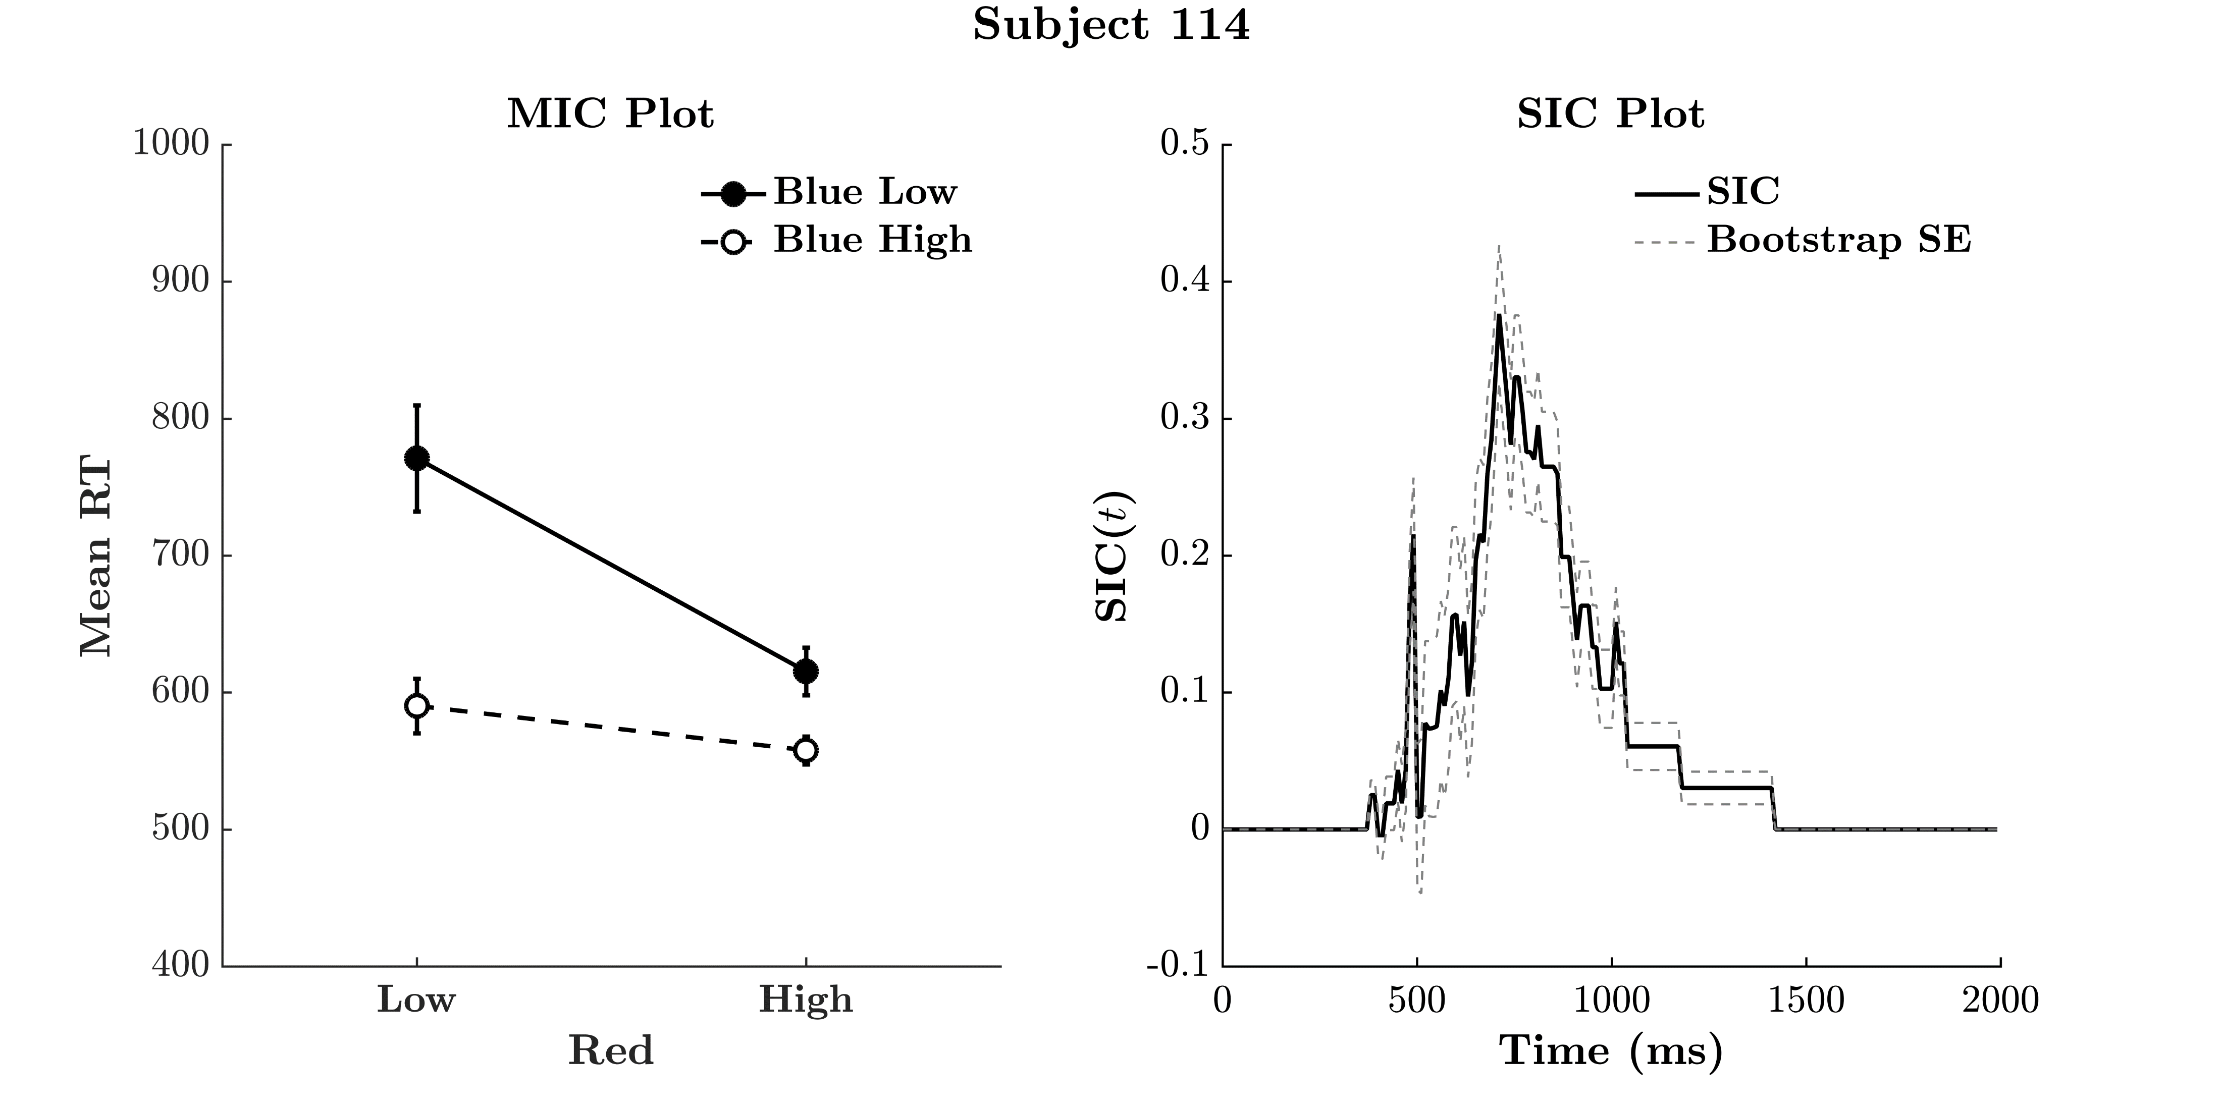
Example Result
Paul Garrett
SPPC 2018
Background
Method
Results
Discussion
Conclusion
- Design
MIC = 123
Notes:
Everyday, we view complex scenes full of countable items.
From, the number of signs in a street,
To the number of plates at a table,
To the Lego carpeting your floor.
At a young age, we learn to focus our attention to a sub-set of these items, and enumerate their quantity.
To do this, we may apply one of two methods: counting, or estimation.
Counting is a slow and deliberate process, where we quantify the item-set by sequentially counting every single unit
Estimation is a fast, and rather inaccurate process, where we quantify the item-set all at the same time.

Slide 20
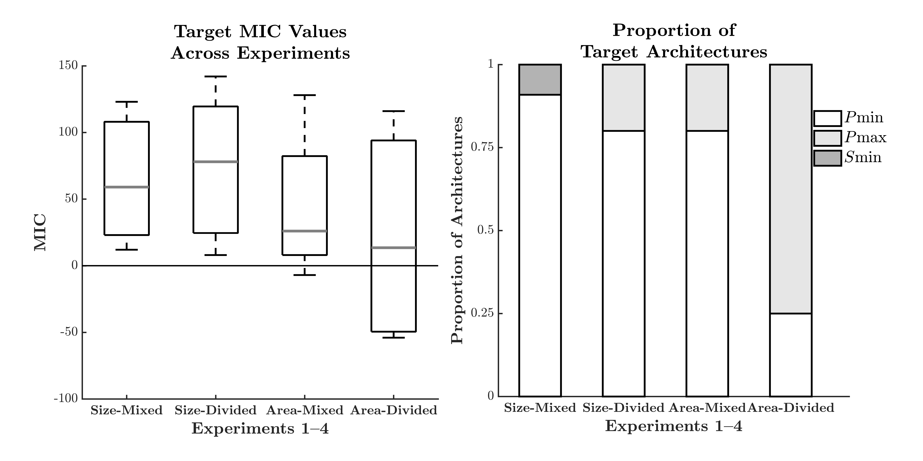
Processing Architecture
Paul Garrett
SPPC 2018
Background
Method
Results
Discussion
Conclusion
- Architecture
Notes:
Everyday, we view complex scenes full of countable items.
From, the number of signs in a street,
To the number of plates at a table,
To the Lego carpeting your floor.
At a young age, we learn to focus our attention to a sub-set of these items, and enumerate their quantity.
To do this, we may apply one of two methods: counting, or estimation.
Counting is a slow and deliberate process, where we quantify the item-set by sequentially counting every single unit
Estimation is a fast, and rather inaccurate process, where we quantify the item-set all at the same time.

Slide 21

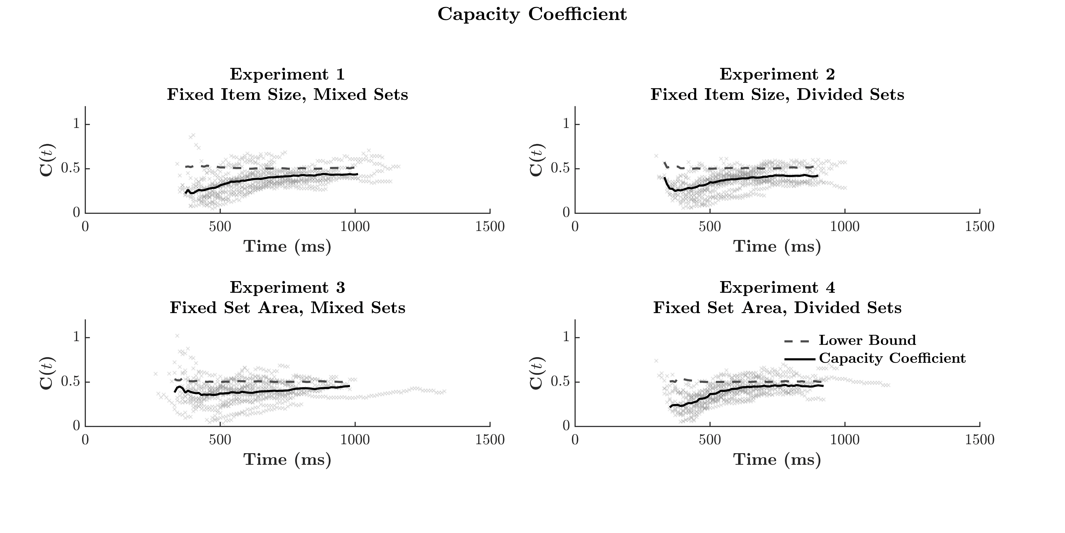
Workload Capacity
Paul Garrett
SPPC 2018
Background
Method
Results
Discussion
Conclusion
- Capacity
Notes:
Everyday, we view complex scenes full of countable items.
From, the number of signs in a street,
To the number of plates at a table,
To the Lego carpeting your floor.
At a young age, we learn to focus our attention to a sub-set of these items, and enumerate their quantity.
To do this, we may apply one of two methods: counting, or estimation.
Counting is a slow and deliberate process, where we quantify the item-set by sequentially counting every single unit
Estimation is a fast, and rather inaccurate process, where we quantify the item-set all at the same time.

Slide 22
Systems Factorial Technology (SFT)
Paul Garrett
SPPC 2018
Background
Method
Results
Discussion
Conclusion
- SFT
Notes:
Everyday, we view complex scenes full of countable items.
From, the number of signs in a street,
To the number of plates at a table,
To the Lego carpeting your floor.
At a young age, we learn to focus our attention to a sub-set of these items, and enumerate their quantity.
To do this, we may apply one of two methods: counting, or estimation.
Counting is a slow and deliberate process, where we quantify the item-set by sequentially counting every single unit
Estimation is a fast, and rather inaccurate process, where we quantify the item-set all at the same time.

Slide 23
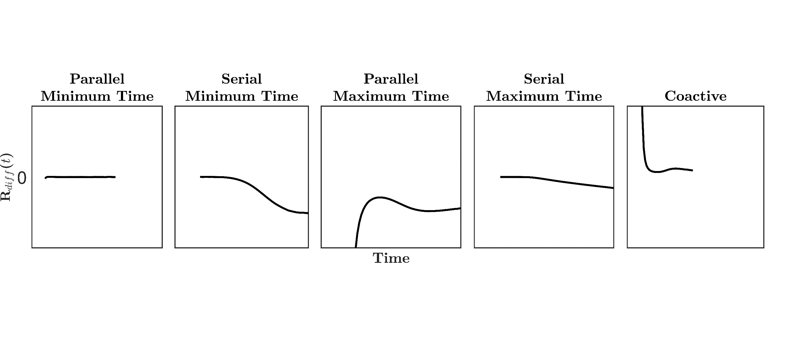
Even More Workload Capacity
Paul Garrett
SPPC 2018
Background
Method
Results
Discussion
Conclusion
$$Rdiff\left(t\right)=log\frac{S\left(t\right)DoubleAB}{S\left(t\right)DistractorAH+S\left(t\right)DistractorBH }−log\frac{S\left(t\right)DoubleAB}{S\left(t\right)DistractorAL+S\left(t\right)DistractorBL }$$
- Capacity
Notes:
Everyday, we view complex scenes full of countable items.
From, the number of signs in a street,
To the number of plates at a table,
To the Lego carpeting your floor.
At a young age, we learn to focus our attention to a sub-set of these items, and enumerate their quantity.
To do this, we may apply one of two methods: counting, or estimation.
Counting is a slow and deliberate process, where we quantify the item-set by sequentially counting every single unit
Estimation is a fast, and rather inaccurate process, where we quantify the item-set all at the same time.

Slide 24

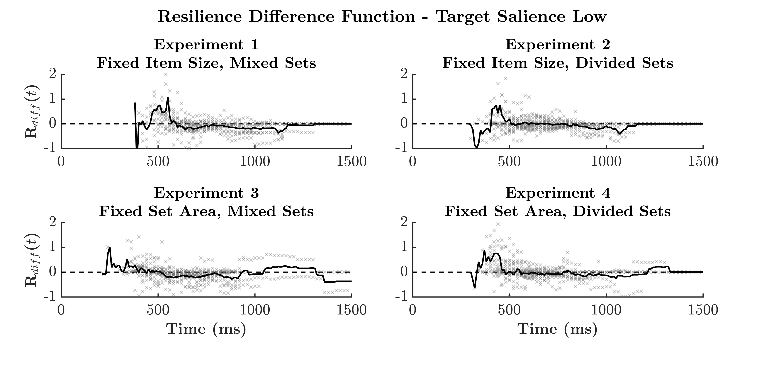
Workload Capacity
Paul Garrett
SPPC 2018
Background
Method
Results
Discussion
Conclusion
- Capacity
Notes:
Everyday, we view complex scenes full of countable items.
From, the number of signs in a street,
To the number of plates at a table,
To the Lego carpeting your floor.
At a young age, we learn to focus our attention to a sub-set of these items, and enumerate their quantity.
To do this, we may apply one of two methods: counting, or estimation.
Counting is a slow and deliberate process, where we quantify the item-set by sequentially counting every single unit
Estimation is a fast, and rather inaccurate process, where we quantify the item-set all at the same time.

Slide 25

Result Summary
Paul Garrett
SPPC 2018
Background
Method
Results
Discussion
Conclusion
Architecture
- Parallel First Terminating (Minimum-Time)
Workload – Single Target (item-set) vs Double Target
- Severely Limited (slow) Capacity
Workload – Target + Distractor vs Double Target
- Unlimited (fast) Capacity
- Summary
Notes:
Everyday, we view complex scenes full of countable items.
From, the number of signs in a street,
To the number of plates at a table,
To the Lego carpeting your floor.
At a young age, we learn to focus our attention to a sub-set of these items, and enumerate their quantity.
To do this, we may apply one of two methods: counting, or estimation.
Counting is a slow and deliberate process, where we quantify the item-set by sequentially counting every single unit
Estimation is a fast, and rather inaccurate process, where we quantify the item-set all at the same time.

Slide 26

Too Many Discs On The Dancefloor
Paul Garrett
SPPC 2018
Background
Method
Results
Discussion
Conclusion
- Summary
Too Many Discs!
Notes:
Everyday, we view complex scenes full of countable items.
From, the number of signs in a street,
To the number of plates at a table,
To the Lego carpeting your floor.
At a young age, we learn to focus our attention to a sub-set of these items, and enumerate their quantity.
To do this, we may apply one of two methods: counting, or estimation.
Counting is a slow and deliberate process, where we quantify the item-set by sequentially counting every single unit
Estimation is a fast, and rather inaccurate process, where we quantify the item-set all at the same time.

Slide 27
Subitizing Quick Study
Paul Garrett
SPPC 2018
Background
Method
Results
Discussion
Conclusion
Subitizing
- Rapid & Accurate
- Enumeration of 1 – 4 Items
- Enumerates all items simultaneously
- Subitizing
Notes:
Everyday, we view complex scenes full of countable items.
From, the number of signs in a street,
To the number of plates at a table,
To the Lego carpeting your floor.
At a young age, we learn to focus our attention to a sub-set of these items, and enumerate their quantity.
To do this, we may apply one of two methods: counting, or estimation.
Counting is a slow and deliberate process, where we quantify the item-set by sequentially counting every single unit
Estimation is a fast, and rather inaccurate process, where we quantify the item-set all at the same time.

Slide 28
Subitizing Quick Study
Paul Garrett
SPPC 2018
Subitizing
- Rapid & Accurate
- Enumeration of 1 – 4 Items
- Enumerates all items simultaneously
Background
Method
Results
Discussion
Conclusion
Design
- Criteria
- Less than 3: Targets 1 & 2
- Less than 4? Targets 2 & 3
- Subitizing
Notes:
Everyday, we view complex scenes full of countable items.
From, the number of signs in a street,
To the number of plates at a table,
To the Lego carpeting your floor.
At a young age, we learn to focus our attention to a sub-set of these items, and enumerate their quantity.
To do this, we may apply one of two methods: counting, or estimation.
Counting is a slow and deliberate process, where we quantify the item-set by sequentially counting every single unit
Estimation is a fast, and rather inaccurate process, where we quantify the item-set all at the same time.

Slide 29
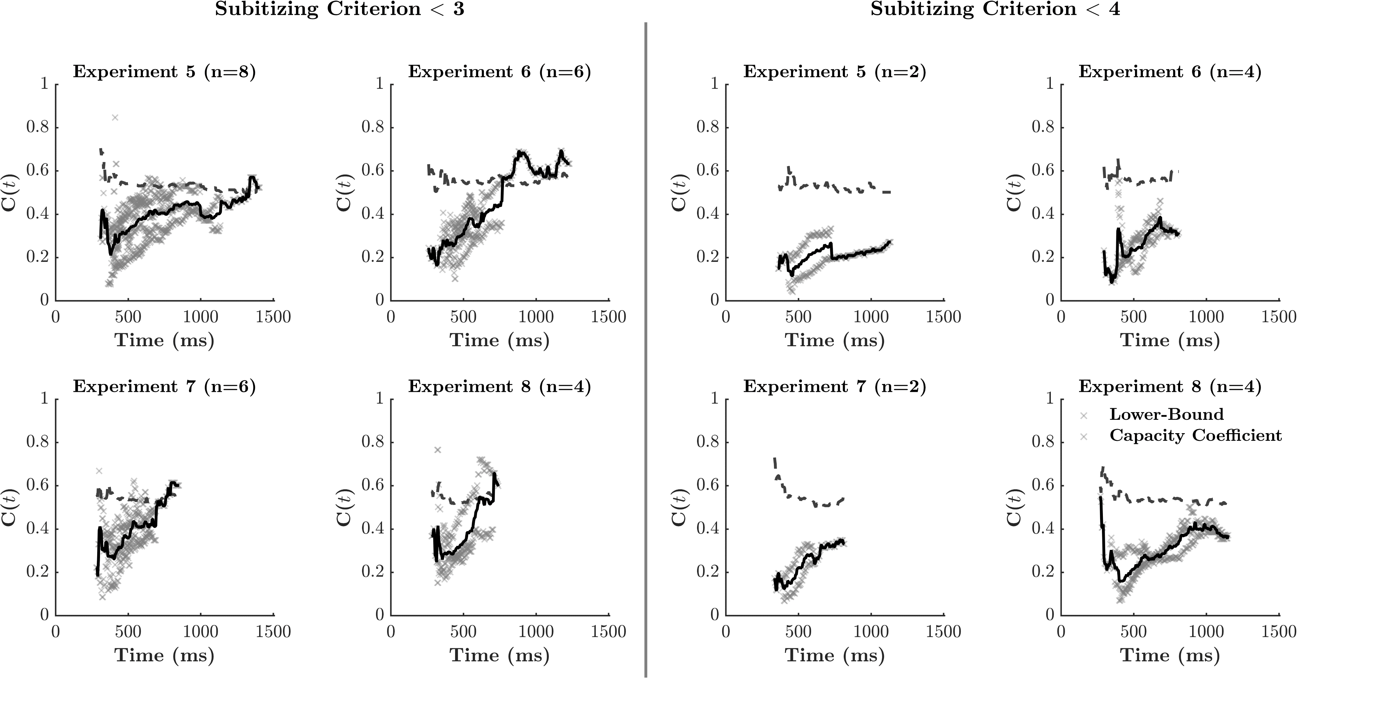
Workload Capacity
Paul Garrett
SPPC 2018
Background
Method
Results
Discussion
Conclusion
- Subitizing
Notes:
Everyday, we view complex scenes full of countable items.
From, the number of signs in a street,
To the number of plates at a table,
To the Lego carpeting your floor.
At a young age, we learn to focus our attention to a sub-set of these items, and enumerate their quantity.
To do this, we may apply one of two methods: counting, or estimation.
Counting is a slow and deliberate process, where we quantify the item-set by sequentially counting every single unit
Estimation is a fast, and rather inaccurate process, where we quantify the item-set all at the same time.

Slide 30
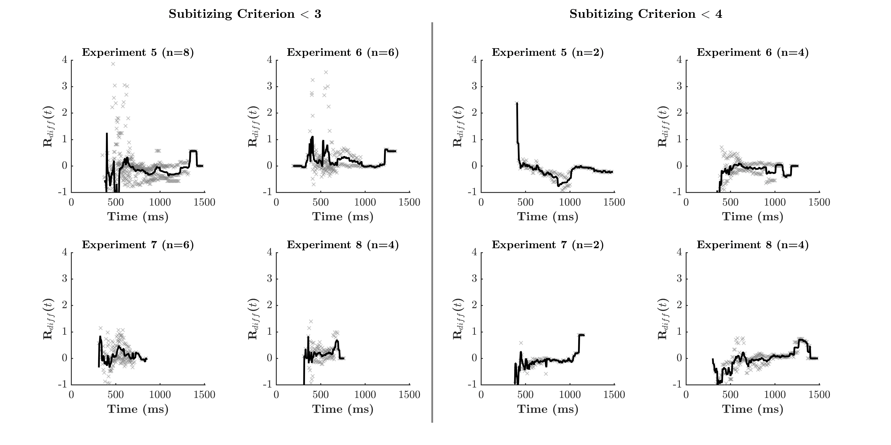
Workload Capacity
Paul Garrett
SPPC 2018
Background
Method
Results
Discussion
Conclusion
- Subitizing
Notes:
Everyday, we view complex scenes full of countable items.
From, the number of signs in a street,
To the number of plates at a table,
To the Lego carpeting your floor.
At a young age, we learn to focus our attention to a sub-set of these items, and enumerate their quantity.
To do this, we may apply one of two methods: counting, or estimation.
Counting is a slow and deliberate process, where we quantify the item-set by sequentially counting every single unit
Estimation is a fast, and rather inaccurate process, where we quantify the item-set all at the same time.

Slide 31
Result Summary
Paul Garrett
SPPC 2018
Background
Method
Results
Discussion
Conclusion
Workload – Single Target (item-set) vs Double Target
- Severely Limited (slow) Capacity
Workload – Target + Distractor vs Double Target
- Unlimited (fast) Capacity
- Summary
Notes:
Everyday, we view complex scenes full of countable items.
From, the number of signs in a street,
To the number of plates at a table,
To the Lego carpeting your floor.
At a young age, we learn to focus our attention to a sub-set of these items, and enumerate their quantity.
To do this, we may apply one of two methods: counting, or estimation.
Counting is a slow and deliberate process, where we quantify the item-set by sequentially counting every single unit
Estimation is a fast, and rather inaccurate process, where we quantify the item-set all at the same time.

Slide 32
Context Effects
Paul Garrett
SPPC 2018
Background
Method
Results
Discussion
Conclusion
- Summary
Notes:
Everyday, we view complex scenes full of countable items.
From, the number of signs in a street,
To the number of plates at a table,
To the Lego carpeting your floor.
At a young age, we learn to focus our attention to a sub-set of these items, and enumerate their quantity.
To do this, we may apply one of two methods: counting, or estimation.
Counting is a slow and deliberate process, where we quantify the item-set by sequentially counting every single unit
Estimation is a fast, and rather inaccurate process, where we quantify the item-set all at the same time.

Slide 33
Context Effects
Paul Garrett
SPPC 2018
Background
Method
Results
Discussion
Conclusion
- Summary
Notes:
Everyday, we view complex scenes full of countable items.
From, the number of signs in a street,
To the number of plates at a table,
To the Lego carpeting your floor.
At a young age, we learn to focus our attention to a sub-set of these items, and enumerate their quantity.
To do this, we may apply one of two methods: counting, or estimation.
Counting is a slow and deliberate process, where we quantify the item-set by sequentially counting every single unit
Estimation is a fast, and rather inaccurate process, where we quantify the item-set all at the same time.

Slide 34
Context Effects
Paul Garrett
SPPC 2018
Background
Method
Results
Discussion
Conclusion
F
- Summary
Notes:
Everyday, we view complex scenes full of countable items.
From, the number of signs in a street,
To the number of plates at a table,
To the Lego carpeting your floor.
At a young age, we learn to focus our attention to a sub-set of these items, and enumerate their quantity.
To do this, we may apply one of two methods: counting, or estimation.
Counting is a slow and deliberate process, where we quantify the item-set by sequentially counting every single unit
Estimation is a fast, and rather inaccurate process, where we quantify the item-set all at the same time.

Slide 35
Context Effects
Paul Garrett
SPPC 2018
Background
Method
Results
Discussion
Conclusion
HEF
- Summary
Notes:
Everyday, we view complex scenes full of countable items.
From, the number of signs in a street,
To the number of plates at a table,
To the Lego carpeting your floor.
At a young age, we learn to focus our attention to a sub-set of these items, and enumerate their quantity.
To do this, we may apply one of two methods: counting, or estimation.
Counting is a slow and deliberate process, where we quantify the item-set by sequentially counting every single unit
Estimation is a fast, and rather inaccurate process, where we quantify the item-set all at the same time.

Slide 36
Global Item-Set Precedence
Paul Garrett
SPPC 2018
Background
Method
Results
Discussion
Conclusion
- Summary
Notes:
Everyday, we view complex scenes full of countable items.
From, the number of signs in a street,
To the number of plates at a table,
To the Lego carpeting your floor.
At a young age, we learn to focus our attention to a sub-set of these items, and enumerate their quantity.
To do this, we may apply one of two methods: counting, or estimation.
Counting is a slow and deliberate process, where we quantify the item-set by sequentially counting every single unit
Estimation is a fast, and rather inaccurate process, where we quantify the item-set all at the same time.

Slide 37
Global Item-Set Precedence
Paul Garrett
SPPC 2018
Background
Method
Results
Discussion
Conclusion
- Summary
Notes:
Everyday, we view complex scenes full of countable items.
From, the number of signs in a street,
To the number of plates at a table,
To the Lego carpeting your floor.
At a young age, we learn to focus our attention to a sub-set of these items, and enumerate their quantity.
To do this, we may apply one of two methods: counting, or estimation.
Counting is a slow and deliberate process, where we quantify the item-set by sequentially counting every single unit
Estimation is a fast, and rather inaccurate process, where we quantify the item-set all at the same time.

Slide 38
Global Item-Set Precedence
Paul Garrett
SPPC 2018
Background
Method
Results
Discussion
Conclusion
- Summary
Notes:
Everyday, we view complex scenes full of countable items.
From, the number of signs in a street,
To the number of plates at a table,
To the Lego carpeting your floor.
At a young age, we learn to focus our attention to a sub-set of these items, and enumerate their quantity.
To do this, we may apply one of two methods: counting, or estimation.
Counting is a slow and deliberate process, where we quantify the item-set by sequentially counting every single unit
Estimation is a fast, and rather inaccurate process, where we quantify the item-set all at the same time.

Slide 39
Conclusion
Paul Garrett
SPPC 2018
Background
Method
Results
Discussion
Conclusion
People Can Estimate Two Quantities in Parallel i.e., At The Same Time.
This Task is Very Difficult i.e., Slower than estimating one set, then the other.
This Difficulty is not due to the number of items i.e., Applies to small item-sets
Difficulty may be due to Context Effects or Item-Set Precedence
Notes:
Everyday, we view complex scenes full of countable items.
From, the number of signs in a street,
To the number of plates at a table,
To the Lego carpeting your floor.
At a young age, we learn to focus our attention to a sub-set of these items, and enumerate their quantity.
To do this, we may apply one of two methods: counting, or estimation.
Counting is a slow and deliberate process, where we quantify the item-set by sequentially counting every single unit
Estimation is a fast, and rather inaccurate process, where we quantify the item-set all at the same time.

Slide 40
Impact
Paul Garrett
SPPC 2018
Background
Method
Results
Discussion
Conclusion
The way we teach Children to enumerate
- One set at a time! No Distractors!
Understanding the effect of workload on estimation under difficult circumstances
- Emergency Responders to a Scene i.e., How many people need help?
- Choosing the fastest Exit given a fire alarm i.e., Which crowd is smallest?
Understanding how people accurately compare large item-sets.
Notes:
Everyday, we view complex scenes full of countable items.
From, the number of signs in a street,
To the number of plates at a table,
To the Lego carpeting your floor.
At a young age, we learn to focus our attention to a sub-set of these items, and enumerate their quantity.
To do this, we may apply one of two methods: counting, or estimation.
Counting is a slow and deliberate process, where we quantify the item-set by sequentially counting every single unit
Estimation is a fast, and rather inaccurate process, where we quantify the item-set all at the same time.

Slide 41

Impact
Paul Garrett
SPPC 2018
Background
Method
Results
Discussion
Conclusion
At least, most people.
Notes:
Everyday, we view complex scenes full of countable items.
From, the number of signs in a street,
To the number of plates at a table,
To the Lego carpeting your floor.
At a young age, we learn to focus our attention to a sub-set of these items, and enumerate their quantity.
To do this, we may apply one of two methods: counting, or estimation.
Counting is a slow and deliberate process, where we quantify the item-set by sequentially counting every single unit
Estimation is a fast, and rather inaccurate process, where we quantify the item-set all at the same time.

Slide 42
Thank you
Paul Garrett
SPPC 2018
Background
Method
Results
Discussion
Conclusion
Notes:
Everyday, we view complex scenes full of countable items.
From, the number of signs in a street,
To the number of plates at a table,
To the Lego carpeting your floor.
At a young age, we learn to focus our attention to a sub-set of these items, and enumerate their quantity.
To do this, we may apply one of two methods: counting, or estimation.
Counting is a slow and deliberate process, where we quantify the item-set by sequentially counting every single unit
Estimation is a fast, and rather inaccurate process, where we quantify the item-set all at the same time.

Slide 43
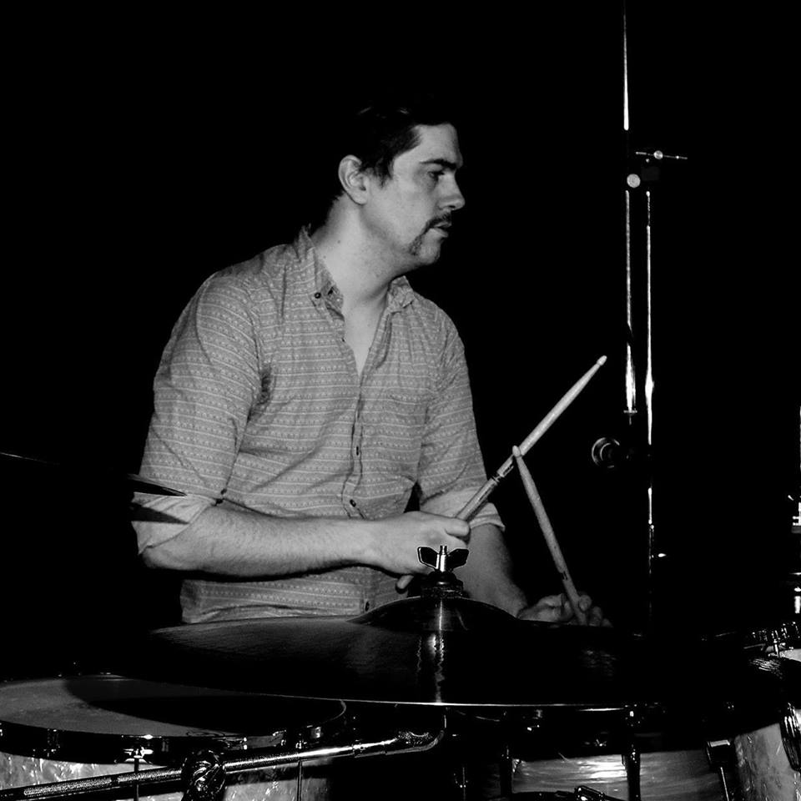

Acknowledgements
Paul Garrett
SPPC 2018
Background
Method
Results
Discussion
Conclusion
Alexander Thorpe
Laura Waters
Notes:
Everyday, we view complex scenes full of countable items.
From, the number of signs in a street,
To the number of plates at a table,
To the Lego carpeting your floor.
At a young age, we learn to focus our attention to a sub-set of these items, and enumerate their quantity.
To do this, we may apply one of two methods: counting, or estimation.
Counting is a slow and deliberate process, where we quantify the item-set by sequentially counting every single unit
Estimation is a fast, and rather inaccurate process, where we quantify the item-set all at the same time.

Slide 44
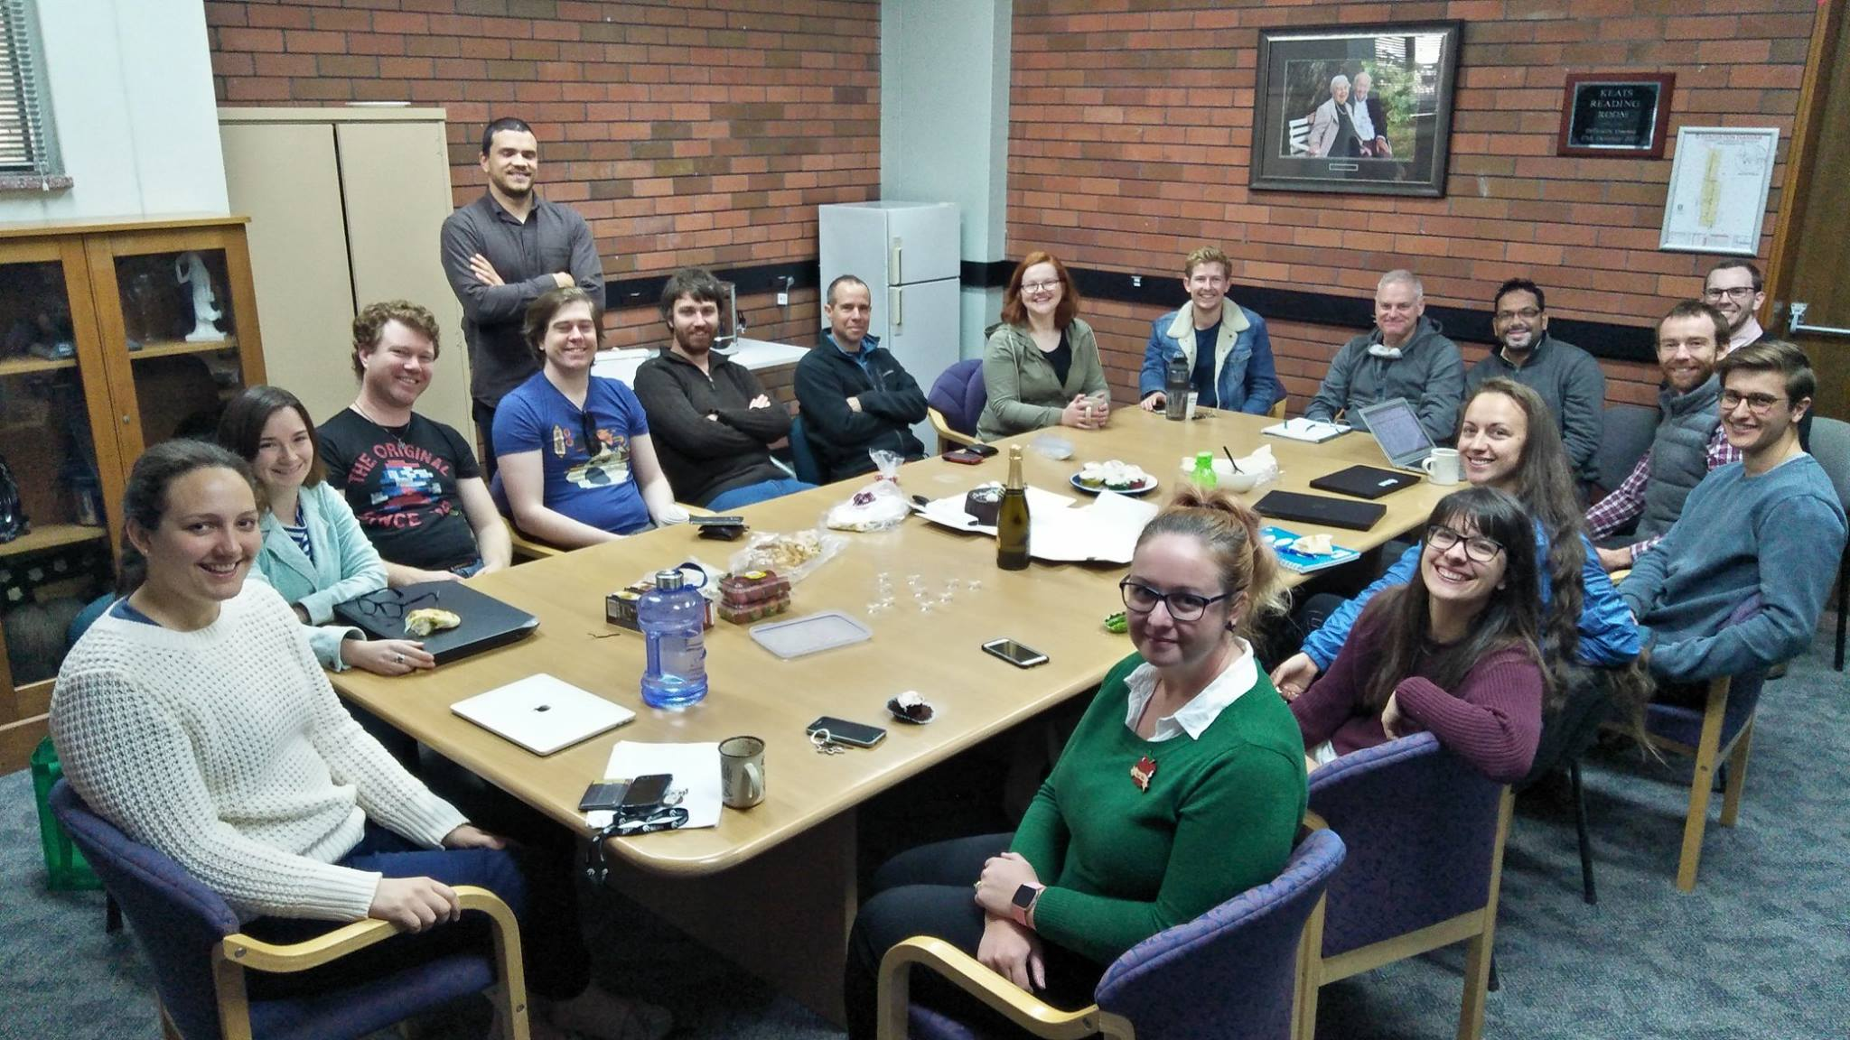
Acknowledgements
Paul Garrett
SPPC 2018
Background
Method
Results
Discussion
Conclusion
Notes:
Everyday, we view complex scenes full of countable items.
From, the number of signs in a street,
To the number of plates at a table,
To the Lego carpeting your floor.
At a young age, we learn to focus our attention to a sub-set of these items, and enumerate their quantity.
To do this, we may apply one of two methods: counting, or estimation.
Counting is a slow and deliberate process, where we quantify the item-set by sequentially counting every single unit
Estimation is a fast, and rather inaccurate process, where we quantify the item-set all at the same time.

